Slide 1


Machine Learning Project
Yassine Boujelbene
Gi2S2

Slide 2
Introduction
Objective: Our goal is to develop a model that accurately predicts house prices based on various features and another model to predict the successful landing of the Falcon 9 first stage.
Importance:
Predicting house prices is crucial for buyers, sellers, and real estate professionals to make informed decisions.
By developing predictions regarding the first stage's landing outcome, we can ascertain the overall launch cost. This information can then be utilized to evaluate whether an alternative company should submit a bid to compete with SpaceX for a rocket launch.

Slide 3
Predicting House prices:
Accurate prediction of house prices is essential for making informed decisions in the real estate market of Ames, Iowa. Utilizing advanced regression techniques and thorough data analysis, our objective is to understand the factors influencing property valuations. Through exploration of property attributes and neighborhood dynamics, we aim to construct predictive models that provide insights into house price trends in Ames, Iowa.

Slide 4

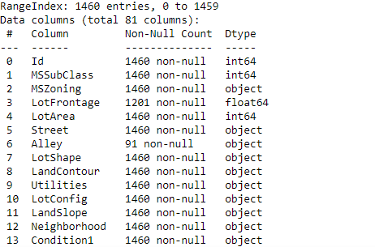



Dataset Overview:
Source: The dataset is sourced from Kaggle's renowned competition.
Description: It contains detailed information on residential homes in Ames, Iowa, including features like lot size, number of bedrooms, quality of materials, etc.
Target Variable: SalePrice - the selling price of the house, our main focus for prediction.

Slide 5
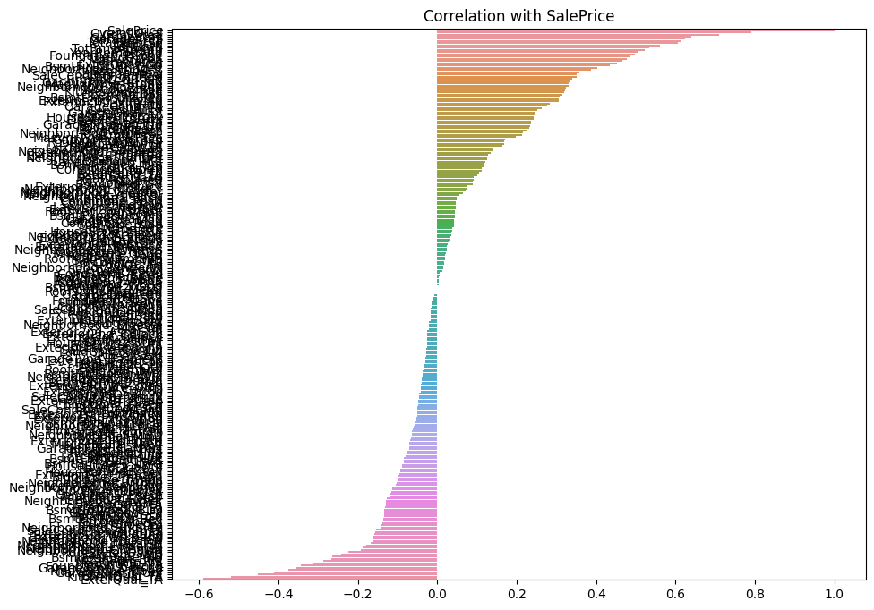
Data Preprocessing:
Handling Missing Values: We meticulously addressed missing values, employing appropriate techniques such as imputation or removal.
Feature Selection: Utilizing correlation analysis, we selected features highly correlated with SalePrice, ensuring our model's relevance.
Data Visualization: We created visualizations to uncover insights into feature relationships and their impact on sale prices.
Standardization: To ensure uniformity and model stability, we standardized our features using the StandardScaler.

Slide 6
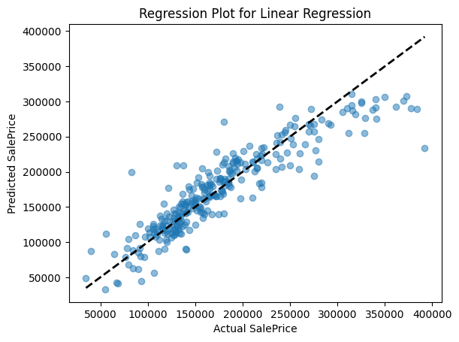
Modelling Approach:
For our modeling approach, we employed three regression techniques tailored to capture the complexities of predicting house prices in Ames, Iowa:
Linear Regression:
Overview: Assumes a linear relationship between features and sale prices.
Application: Serves as our baseline model for comparison.
Ridge Regression:
Overview: Mitigates overfitting with a penalty term.
Tuning: Optimized regularization parameter for balanced performance.
Lasso Regression:
Overview: Facilitates feature selection through regularization.
Optimization: Tuned regularization parameter for accuracy and sparsity.

Slide 7
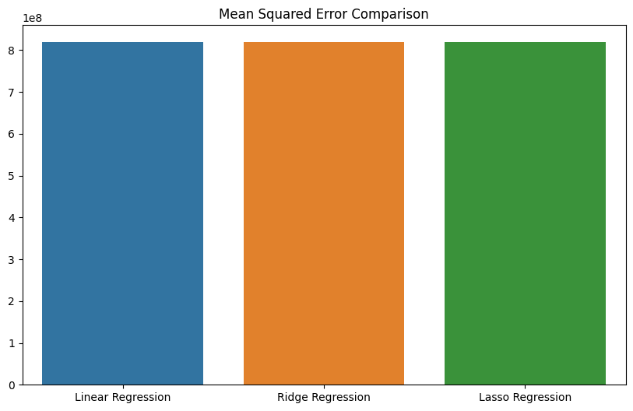
Evaluation:
Metric: We evaluated model performance using Mean Squared Error (MSE), measuring the average squared difference between predicted and actual sale prices.
Comparison: We compared the MSE of all three models to identify the most effective predictor of house prices.

Slide 8

Conclusion:
Implications: Our model provides valuable insights for homeowners, buyers, and real estate professionals, aiding in accurate house price estimation.
Future Directions: Further refinement of the model and exploration of additional features could enhance prediction accuracy and expand applicability.

Slide 9
Predicting Successful Landing:
SpaceX conducts Falcon 9 rocket launches at an approximate expense of $62 million, a notably lower cost compared to other providers whose charges typically exceed $165 million. A significant factor contributing to this cost efficiency is SpaceX's ability to successfully land and reuse the initial stage of the rocket.

Slide 10
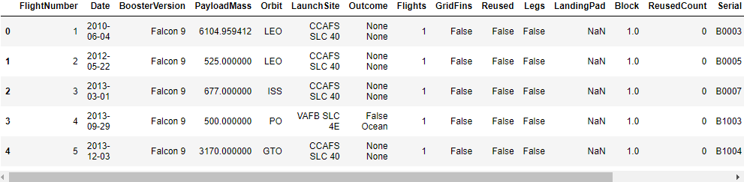
Dataset Overview:
Source: The dataset is compiled from a combination of SpaceX's public API and web scraping of data from SpaceX's Wikipedia entry.
Description: The dataset encompasses comprehensive information on SpaceX's rocket launches, featuring details such as flight number, date, booster version, payload mass, orbit, launch site, and more.
Target Variable: Our main focus for prediction is the successful landing of the Falcon 9 first stage, denoted by the Booster Landing variable. This variable indicates whether the first stage of the rocket successfully landed back on Earth after launch, a critical aspect of SpaceX's reusability strategy.

Slide 11
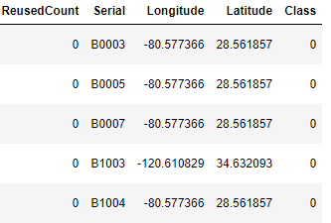
Data Wrangling:
Generate a training label for landing outcomes, categorizing success as 1 and failure as 0.
The 'Outcome' column comprises two elements: 'Mission Outcome' and 'Landing Location.'
Introduce a new training label column named 'class,' assigning a value of 1 if 'Mission Outcome' is true and 0 otherwise. Utilize the following value mapping:
True ASDS, True RTLS, & True Ocean → set to 1
None, None, False ASDS, None ASDS, False Ocean, False RTLS → set to 0.

Slide 12
Modelling Approach:
We utilized four classification techniques for predicting the successful landing of SpaceX's Falcon 9 first stage:
Logistic Regression:
Simple binary classification model, serving as our baseline.
Support Vector Machine (SVM):
Handles complex relationships and non-linear decision boundaries.
Decision Tree:
Captures non-linear patterns and feature interactions.
K-Nearest Neighbors (KNN):
Provides localized approximation of the decision boundary.

Slide 13
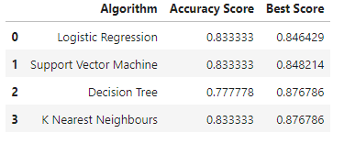
Evaluation:
All models had virtually the same
accuracy on the test set at 83.33%
accuracy. It should be noted that test
size is small at only sample size of 18.
This can cause large variance in
accuracy results, such as those in
Decision Tree Classifier model in
repeated runs.
We likely need more data to determine
the best model.

Slide 14
Conclusion:
Our task: to develop a machine learning model for Space Y who wants to bid against SpaceX
The goal of model is to predict when Stage 1 will successfully land to save ~$100 million USD
Used data from a public SpaceX API and web scraping SpaceX Wikipedia page
Created data labels and stored data into a DB2 SQL database
Created a dashboard for visualization
We created a machine learning model with an accuracy of 83%

Slide 15

Thank you!

